Slide 1
FIBA Official Basketball Rules 2022
______
Rule Changes
National Federations

Slide 2
Overview of the changes
MAJOR
MINOR
Art. 8 End of playing time
Art. 34/37 Throw-in foul – L2M
Art. 37 Unsportsmanlike foul
- C4 improved wording
- C5 eliminated
Appendix A Referee’ Signals
Appendix F Instant Replay
- New text
- Goaltending & Interference
- Head Coach Challenge (HCC)
Art. 4 Uniforms, improved wording (IW)
Art. 9 Direction of play changed
Art. 12 Simplified how 1st alternating possession established
Art. 15 Player in act of shooting – (IW)
Art. 42 Special situations – (IW)
Art. 48-49 Modified duties for scorer and timer
Appendix B New Scoresheet

Slide 3
Minor changes
OBR 2022

Slide 4
Minor Changes
Improved wording & minor changes
Art 4 . Teams
The language “compression sleeves” is replaced by “compression garments”
Minimum size of uniform numbers: back 16 cm (-4 cm), front 8 cm (-2 cm) & minimum distance for advertising 4 cm (-1 cm)
Art 15 . Player in act of shooting
A “player in act of shooting” is now known as a “shooter”
Art 42. Special situations
Definition In the same stopped-clock period which follows an infraction, special situations may arise when additional infraction(s) are or have been committed

Slide 5
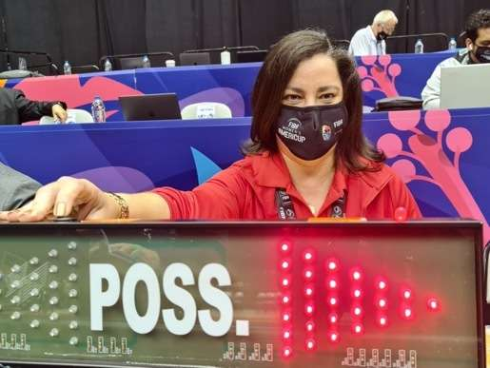
Minor Changes
Improved wording & minor changes
Art 12. Alternating possession arrow
The team that does not gain the first team control of a live ball after the jump ball shall be entitled to the first alternating throw-in. The words “on the playing court” have been deleted.
Art. 48/49 Scorer / Timer
Modifications in duties for scorer and timer: moved 5 personal fouls notification and time-out requests from scorer to timer & added HCC marking to scorer.

Slide 6
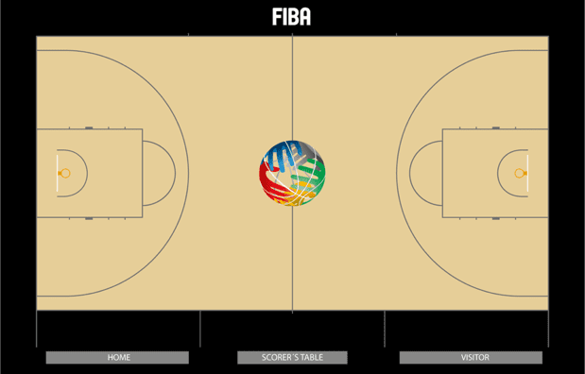
Minor Changes
Improved wording & minor changes
Art. 9 Start and end of a quarter, overtime or the game
Home team bench is the one to the left of scorer’s table
Each team will warm up before the game in front of their team bench
However, by mutual agreement, teams can exchange team bench and/or warm up zone
Appendix A - Scoresheet
Modifications
Before the game
HOME TEAM WARM-UP
VISITING TEAM WARM-UP
HOME
VISITING
Notes:
Warm-up before the game
Home team bench is the one to the left of scorer’s table
Each team will warm up before the game in front of his team bench
However, by mutual agreement, teams can exchange team bench and/or warm up zone
sds

Slide 7
Major changes
OBR 2022

Slide 8
Art. 8 Playing time, tied score and overtime
When a foul is called near the end of the quarter
The referees shall determine if the foul was before time expired
The referees shall determine the remaining playing time and reset the game clock accordingly
The game clock must show at a minimum 1/10 second to administer the foul(s) and penalty
Game clock | Q1, Q2 & Q3 | Q4 & OT
0.1 sec minimum | Foul(s) to be administered
0.0 sec | PF disregarded UF, TF, DF administered as interval of play foul | Any foul disregarded After the game report to the disciplinary body

Slide 9
When a foul is called near the end of the quarter
FOUL CALL and TIME EXPIRES
Referees determine if the foul was in time or not.
Before the time expired
After the time expired
Reset the clock to correct time
Game ended
Game continues
*
Foul penalties administerd
If needed, report to the
disciplinary
body
PF disregarded.
UF, TF, DF administered as interval of play foul.
* In case the game continues with Q2, Q3, Q4 or OT
Notes:
Warm-up before the game
Home team bench is the one to the left of scorer’s table
Each team will warm up before the game in front of his team bench
However, by mutual agreement, teams can exchange team bench and/or warm up zone
sds

Slide 10
Appendix F – Instant Replay System
The timing of IRS review clarified
In situations when the game clock is not stopped with a whistle
Last 2 minutes:
Shot clock violation (successful shot)
Any time:
2- or 3- point basket
If an act of violence has occurred
The referees are authorised to stop the game immediately after the reviewable situation occurs.
Referees must identify the need for the review the first time they have stopped the game for any reason
All the time-outs and any substitutions held until after the final decision is communicated.

Slide 11
Art. 34/37 Throw-in Foul – L2M
Introducing a Throw-in Foul
Unsportsmanlike Foul criteria for L2M throw-in situations (C5) deleted
When? | Throw-in situation in the L2M (4Q or OT)
Who? | A defensive player
What? | A Personal Foul before the ball is released on the throw-in Note: All other UF criteria remains still valid

Slide 12
Art. 34/37 Throw-in Foul – L2M
Introducing a Throw-in Foul
Penalty | One free-throw by the player who is fouled Game resumed by a throw-in at the nearest place to where the foul was committed
Note | Shot clock: 24 seconds if the foul was committed in the backcourt The remaining time, but never less than14 seconds, if the foul was committed in the frontcourt

Slide 13
Art. 37 Unsportsmanlike foul
Unsportsmanlike Criteria ”Clear Path” (C4) clarified
Foul – behind or lateral –
On a player progressing towards opponents’ basket without any other opponent players between him and the basket, and
* = ball is released
(A)
Progressing player controls the ball
(B)
Progressing player attempts to gain control of the ball
(C)
Progressing player. attempts to catch. a pass* made to him/her.
OR
OR

Slide 14
Appendix F – Instant Replay System
The timing of IRS review clarified
General
If a time-out has begun or a substitution has occurred when the referees identify the need for an IRS review, the time-out and any substitutions shall be cancelled until the final decision is communicated.
The head coach may withdraw the time-out request when the final decision is communicated or either head coach may request a time-out, or either team may request a substitution.

Slide 15
IRS – SHOT CLOCK VIOLATION (L2M)
SUCCESSFUL SHOT & SC SOUNDS
(A)
(C)
Before the ball is live for the throw-in after the basket
Referees stop the game for an IRS review
After the ball is live following 1st stop by referees
Violation
After the ball is live for the throw-in after the basket
No
Yes
Time limit for IRS use has ended.
The original decision remains valid.
(B)
SC signal is disregarded. The goal counts.
The goal shall not count.
Defensive throw-in from the place nearest to where the SC violation occurred.
The goal counts.
The SC signal is disregarded.
No
Violation
Yes
The goal shall not count.
Throw-in for the team that had control of the ball when the referees stopped the game, from the place nearest to where the ball was located when the game was stopped, or free throws if applicable.

Slide 16
Appendix F – Instant Replay System
L2M – Goaltending & Basket Interference
L2M
Call GT & BI
No violation
IRS
(A) A valid basket scored | (B) A player has gained an immediate and clear control of the ball (incl. OOB) | (C) Neither team has gained an immediate and clear control of the ball
Throw-in from the endline | Throw-in from the place nearest to where the ball was when the game stopped | A jump ball situation

Slide 17
Appendix F – Instant Replay System
Head Coach’s Challenge
In all games where the Instant Replay System (IRS) is applied the coach may request a head coach’s challenge.
i. e. Ask the referees to verify their decision by using the IRS to review the game situation.

Slide 18
Appendix F – Instant Replay System
Head Coach’s Challenge
The Rule
Only one head coach’s challenge granted per team, regardless of whether the challenge is successful or not.
Only situations as in the Article F.3 may be challenged, without time restrictions.
The head coach’s challenge may be requested at any time in the game. The request shall be final and irreversible.

Slide 19
Appendix F – Instant Replay System
Head Coach’s Challenge
Procedure
Visual contact with the nearest referee
Say loudly in English “challenge” and show the signal
Must request at the latest when game is stopped for the first time after the decision to be reviewed
Indicate the situation to be reviewed to the nearest referee
Referees confirm the requested challenge is valid and the head coach’s challenge has been granted

Slide 20
Appendix F – Instant Replay System
Head Coach’s Challenge
Procedure
During the IRS review the players remain on the court
If the challenge is successful, the initial decision is overturned
If the challenge is not successful, the initial decision remains
Referees use the same procedure as in the IRS review rule
Game shall be resumed as after any IRS review

Slide 21
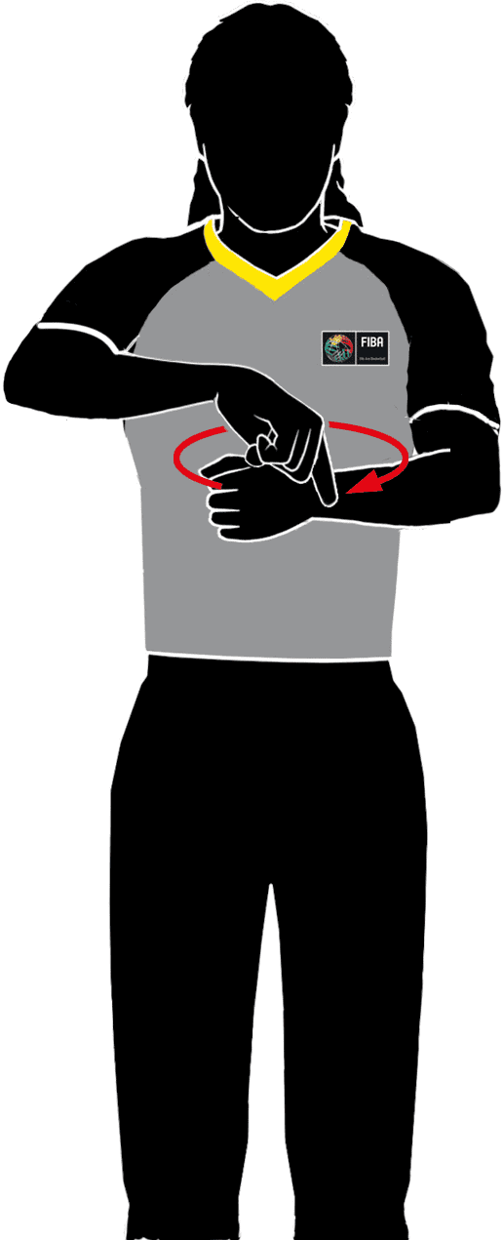
Appendix A - New signals
Goaltending & Basket Interference
Rotate finger, extend index finger over the other hand with a large circle
– replicating the size of the ring.
Remember
VERBAL SUPPORT!

Slide 22
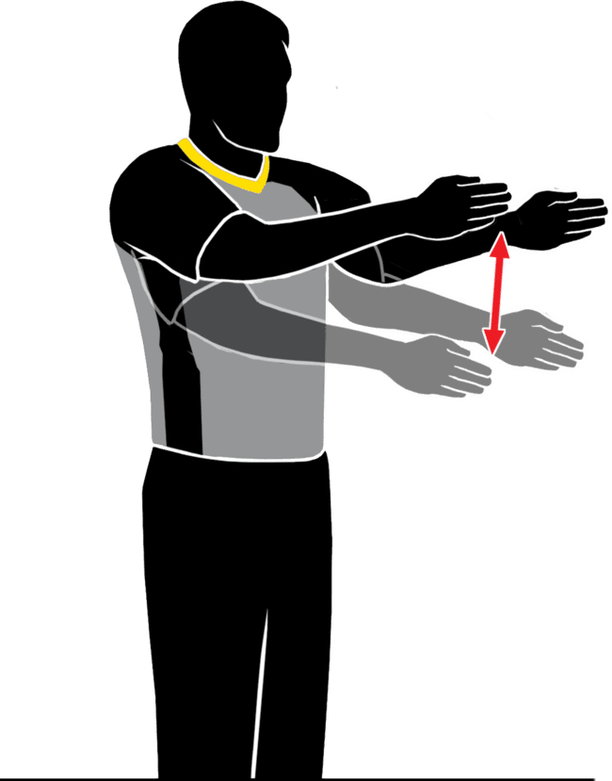
Appendix A - New signals
Cylinder Play
Both arms with hands vertical moving up and down.
It is critical to use your voice on all decisions. Even more so with new signals.
VERBAL SUPPORT!
USE ONLY IN CYLINDER PLAY FOULS!

Slide 23
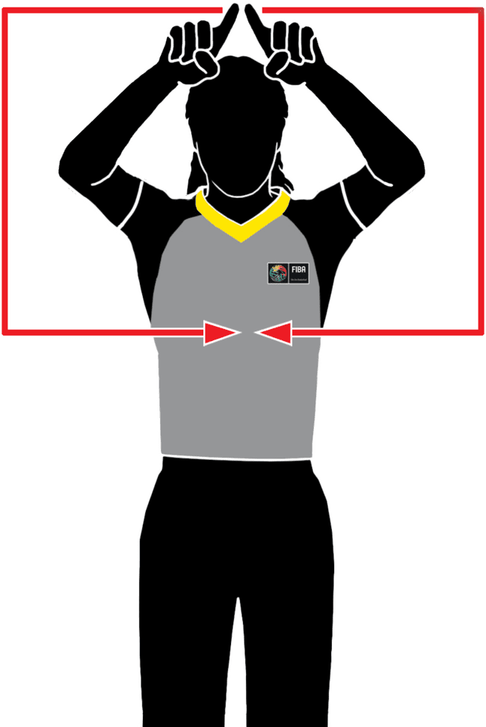
Appendix A - New signals
Head Coach’s Challenge
When granting the HCC request, draw a rectangle with your index fingers

Slide 24
IOT MANUAL Changes
OBR 2022

Slide 25
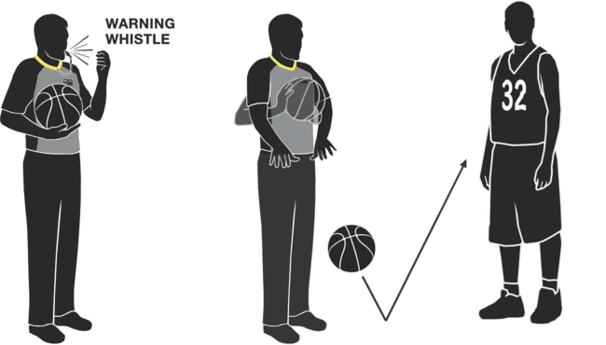
FIBA IOT MANUAL UPDATE – WARNING WHISTLE
A “warning whistle” should occur:
Prior to crew chief (CC) entering the jump circle for the opening toss
Prior to ball being placed at the disposal of the thrower-in at the start of each new quarter or overtime
Prior to ball being placed at the disposal of the thrower-in on a frontcourt endline throw-in
Prior to ball being placed at the disposal of the thrower-in to restart the game after a time-out

Slide 26
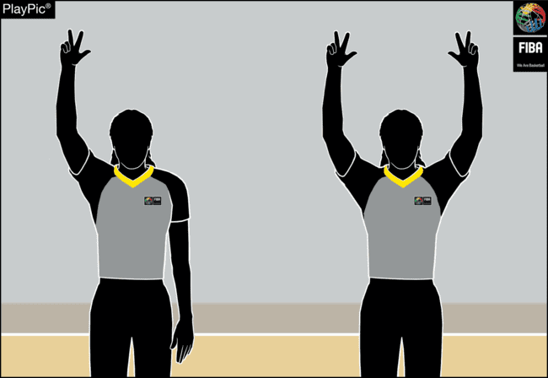
FIBA IOT MANUAL UPDATE – 3 POINT SHOT
The correct mechanic on a 3 points shot is:
only the primary referee (trail or center) signals a 3-point attempt
the other outside referee (trail or center) does not mirror the attempt
in dual coverage area both outside referees (trail and centre) may signal the attempt
if the basket is made, both outside referees (trail and centre) signal the successful basket

